Slide 1
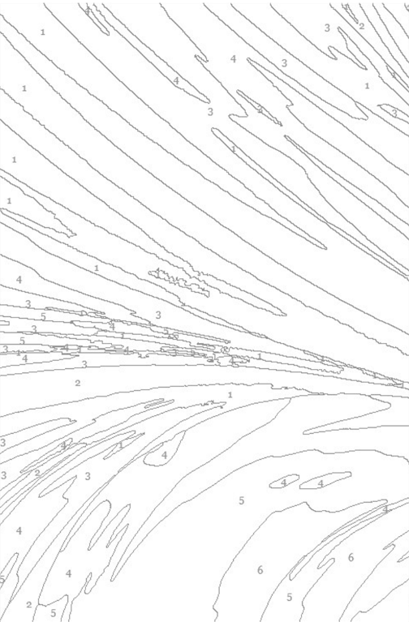

Python： 外星人入侵小游戏
MADE BY
Dora Yonah Lucy

Slide 2

Alien Invasion Project Plan:
Alien Invasion Project Plan: A spaceship appears at the bottom of the screen, moving left and right, and shooting with the space bar. At the beginning, the alien spaceship appears at the top of the screen and moves downward. The player's task is to shoot these spaceships. Every time the screen is cleared, a group of new spaceships appear, and the new spaceships move faster. When the new spaceships move to collide with the player's spaceship or hit the bottom of the screen, the player loses one spaceship. After losing three spaceships, the game ends.

Slide 3
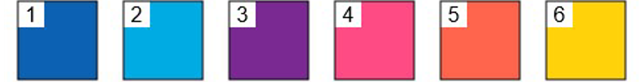
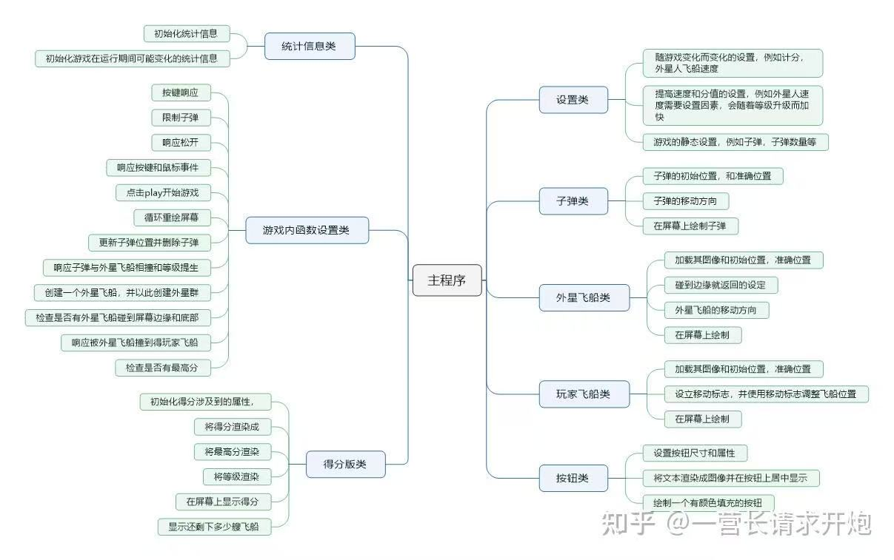
Program composition

Slide 4
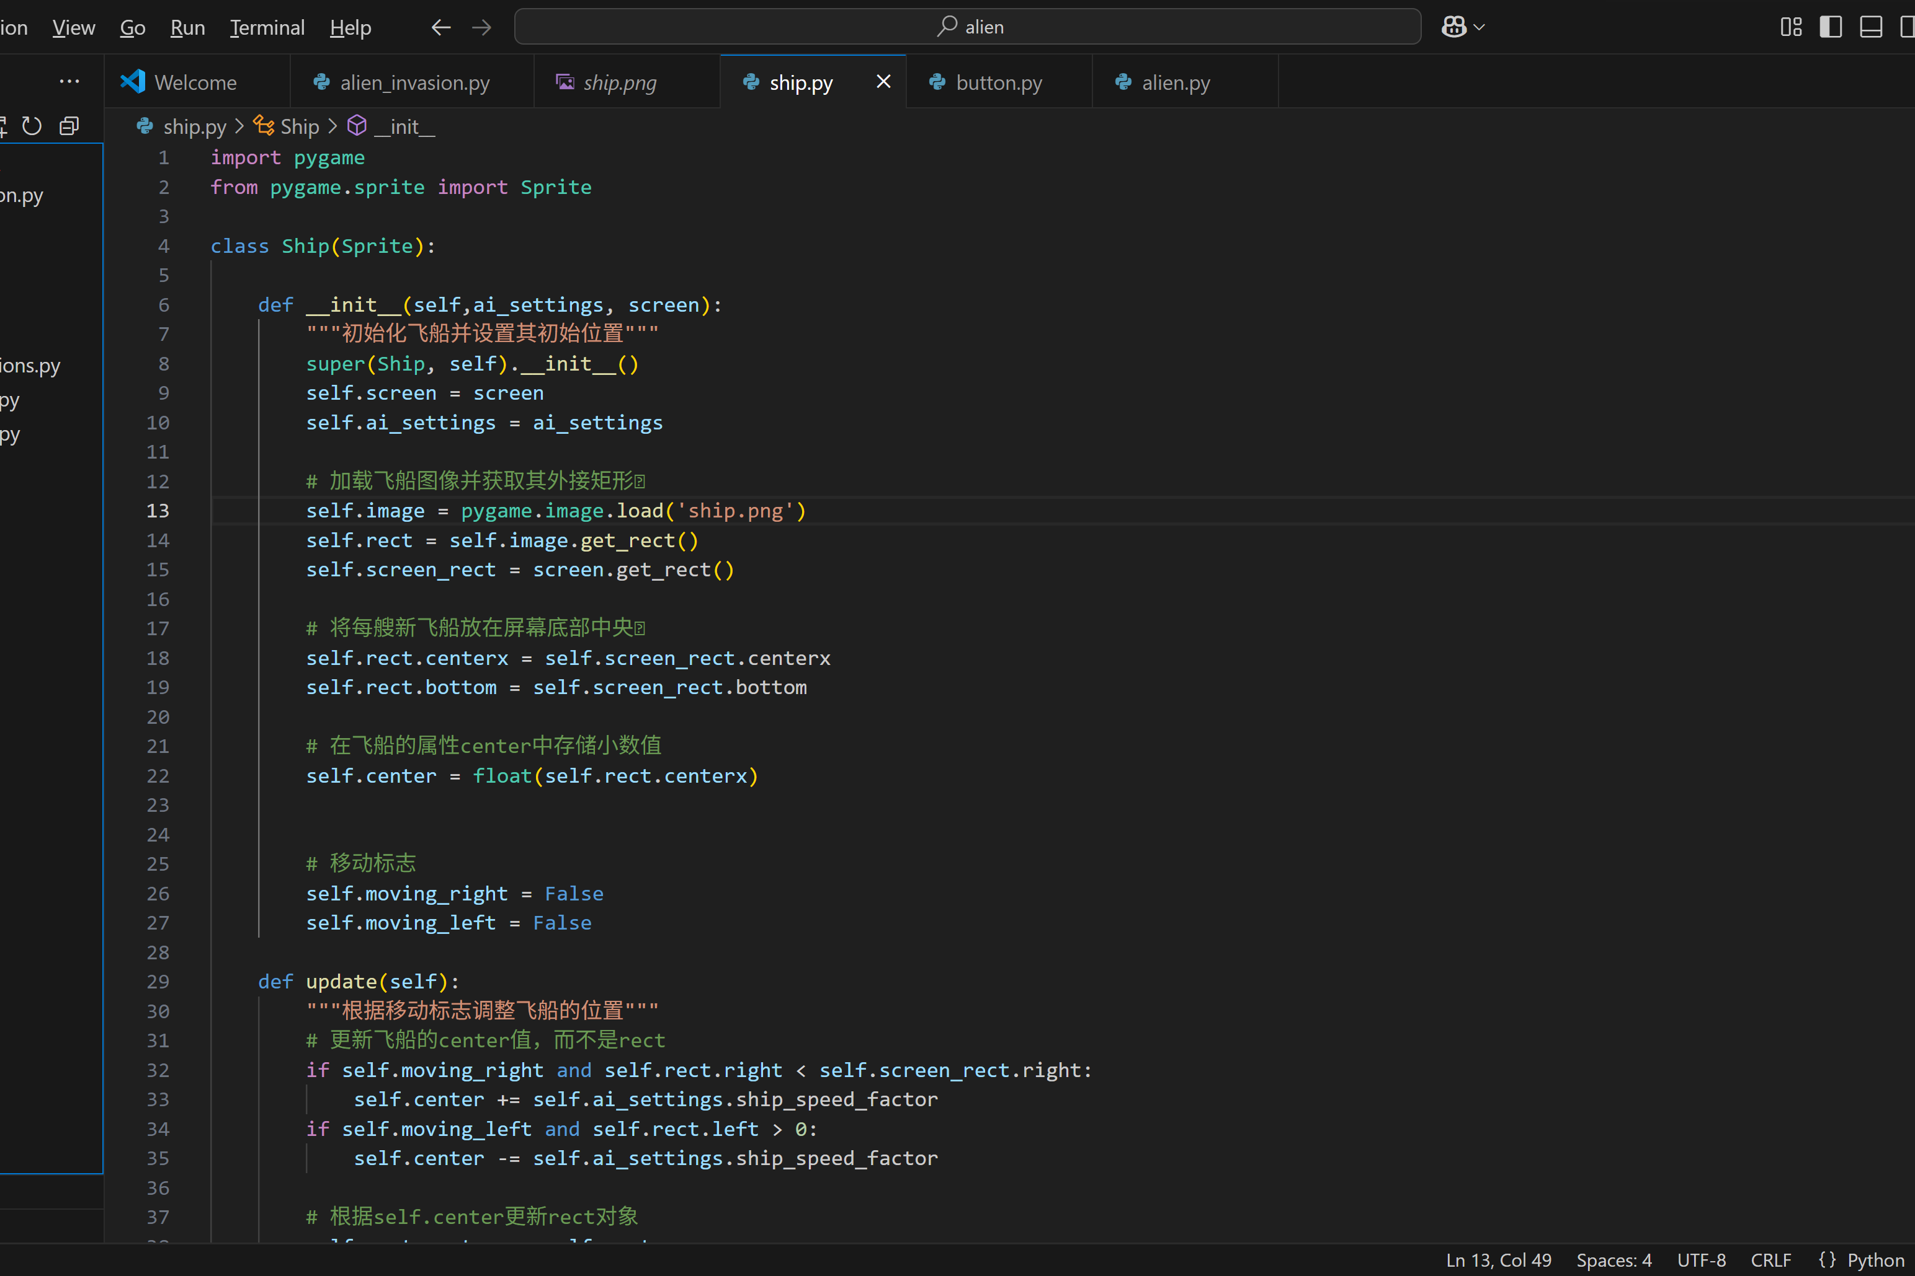
Main program display

Slide 5
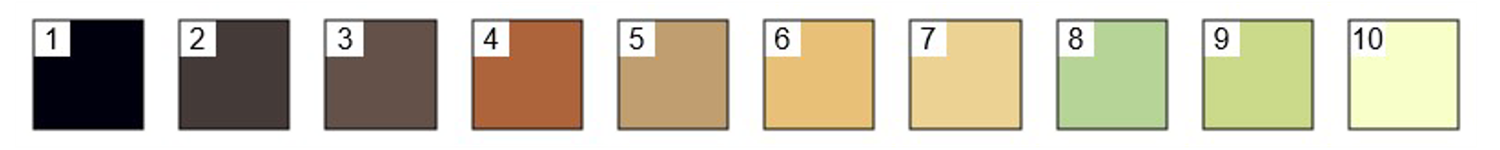
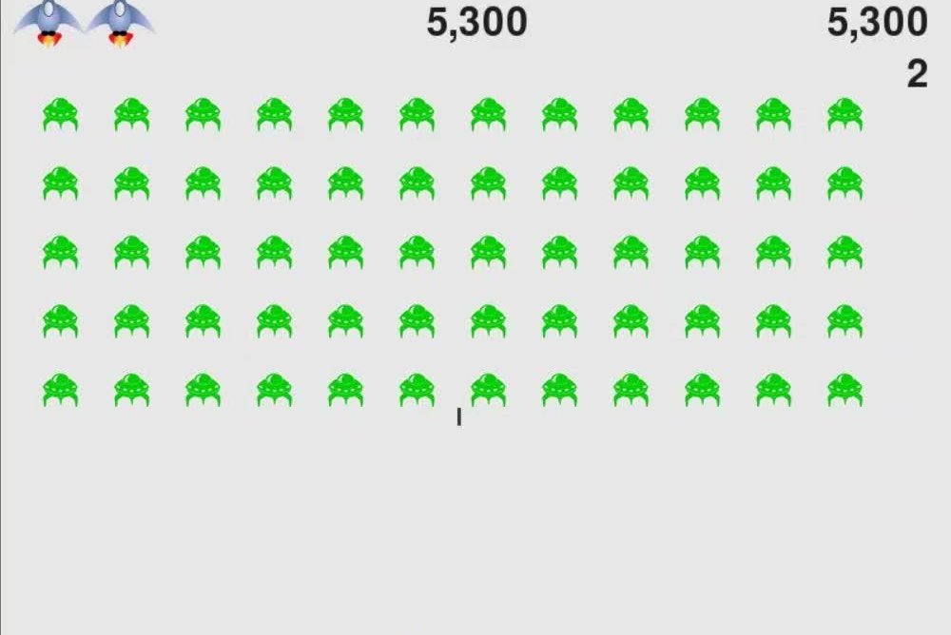
Game interface display

Slide 6

Thank you!

